Slide 1
Veritas Bank
Analysis Report

Slide 2
Executive Report
Veritas Bank is a UK-headquartered technology-driven retail bank established in the 1990s with major operations across Germany and France.
Veritas Bank for the duration covered by this analysis has 10,000 customers, a total balance of £271.5 million, 4 products, and an average customer credit score of 651.
On the other hand, Veritas bank has a churn rate of 14%, Churn Balance is 22.59 million which is 8% of the total balance, a maximum tenure of 10 years and an average tenure of 5 years

Slide 3
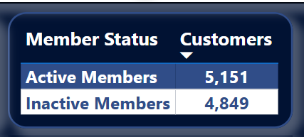
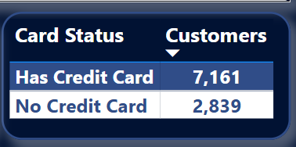
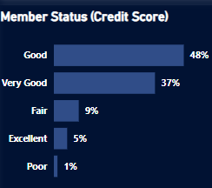
Customer Analysis
Member Status:
Active Members: 52%
Inactive Members:48%
Card Status:
Credit Card Members:72%
No Credit Card Members:28%
Credit Score Status (Equifax):
Good: 4,763 Members
Very good: 3,707 Members
Fair: 912 Members
Excellent: 487 Members
Poor: 131 Members

Slide 4
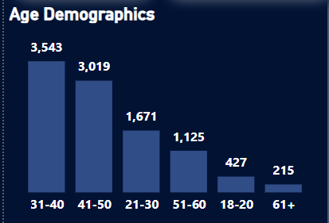
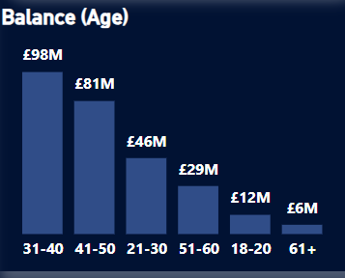
Customer Analysis
Age Demographics:
Most Members are between:31-40
The least age is: 61+
Bank Balance:
Age 31-40 has the highest balance:36%
Age 61+ has the least balance:28%
This trend cuts across credit card and membership status
It indicates that the most productive customers
are within their career prime while the least
productive are likely retirees.

Slide 5
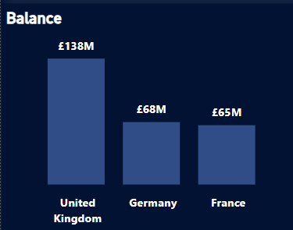
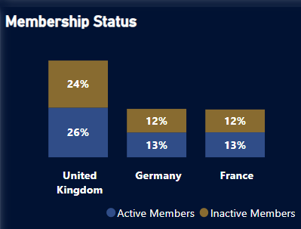
Segment Analysis
Regional Bank Balance
United Kingdom: 51%
Germany: 25%
France: 24%
Regional Membership Status
United Kingdom client base: 50%
Germany client base: 25%
France client base: 25%
Credit card status share similar trend.

Slide 6
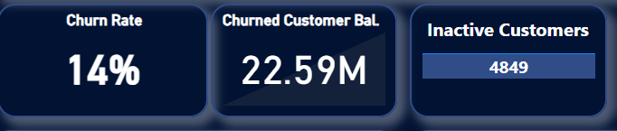
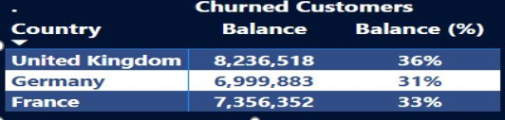
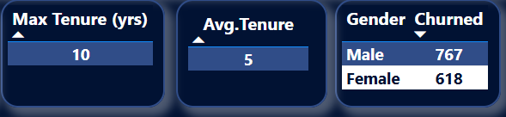
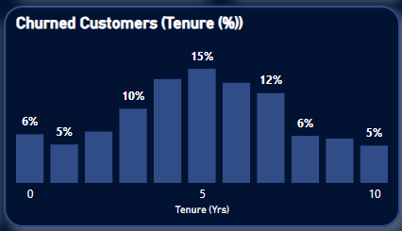
Churn Analysis
Churned Customer Status:
Total churned customers: 1385
Balance from churned customers: 8%
Inactive customers: 48%
Churned Customer Gender:
Male gender: 55%
Female gender: 45%
Churned Customer Tenure:
Maximum customer tenure : 10 years
Average tenure: 5 years

Slide 7
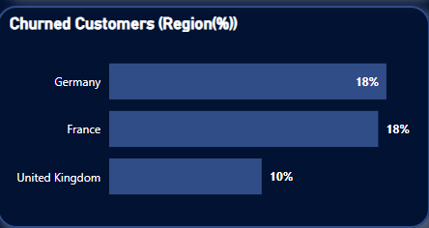
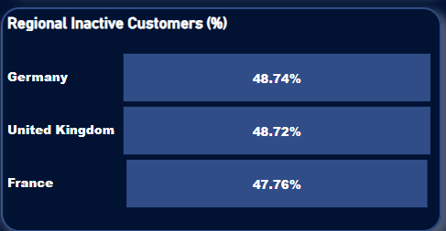
Churn Analysis
Churned Customer Region:
Germany: 453 customers
France:434 customers
United Kingdom: 498 customers
Regional Inactive Customers:
Germany: 1223 customers
United Kingdom: 2,443 customers
France: 1183 customers

Slide 8
Recommendations
A review of product offering is required with the aim of tackling the high inactive membership rate
Sales and Marketing strategies geared towards improving customer interaction is essential.
Customer retention strategies should be implemented across board and intensified for customers whose tenure in the bank has passed the five year benchmark
Product incentives targeted towards customers below twenty-one and above 60 should be implemented as a way to boost customer attraction and retention for this age demographics
Sales and Marketing strategies for Germany and France needs to be reviewed and enhanced

Slide 9
.
Thank You
Precious Akams

